Slide 1
CET3003B Full Stack Development
Zero Hour

Slide 2
Course at Glance
Course Code | CET3003B
Course Category | Core Engineering
Course Title | Full Stack Development Technologies
Teaching Scheme and Credits Weekly load hrs | Lectures | Tutorial | Laboratory | Credits
 | - | - | 4 | 2
Pre-requisites: Principles of Programming Languages Computer Networks Co-requisite Database Management Systems

Slide 3

Faculties
Prof. Aniket Ingawale
Prof. Dipali Baviskar
Prof. Jyoti Gavhane
Prof. Vaishali Suryawanshi
Prof. Sagar Apune
Dr. Sanket Salvi
Mr. Prasad Chitale
Dr. Prasad Purnaye (Course Coordinator)

Slide 4
About Course
Course Objectives
Knowledge
To understand best practices for web-site project development.
To understand the frontend and backend technologies for web application development.
Skills
To acquire skills for developing web applications using frontend and backend technologies.
To acquire skills for deployment processes for real world web-based applications.
Attitude
To use best practices for developing a dynamic and responsive website.
To use various technology stack such as MEAN and MERN for developing a website.

Slide 5
Course Outcomes:
After completion of the course, the students will be able to:
To apply best practices to design and develop dynamic and responsive web pages.
To select and apply appropriate frontend technologies for responsive User Interface (UI) development
To design and develop web applications using various technology stacks.
Test and deploy real world web-based applications on different platforms.

Slide 6
Related MOOCs and Certifications (Optional)
1. Introduction to Modern Application Development - NPTEL
2. Full Stack Developer (Summer Training) - IIT Kanpur
3. Full Stack Developer Nanodegree Udacity
4. Full Stack Mobile App Development – Coursera

Slide 7
Assessment Scheme

Slide 8
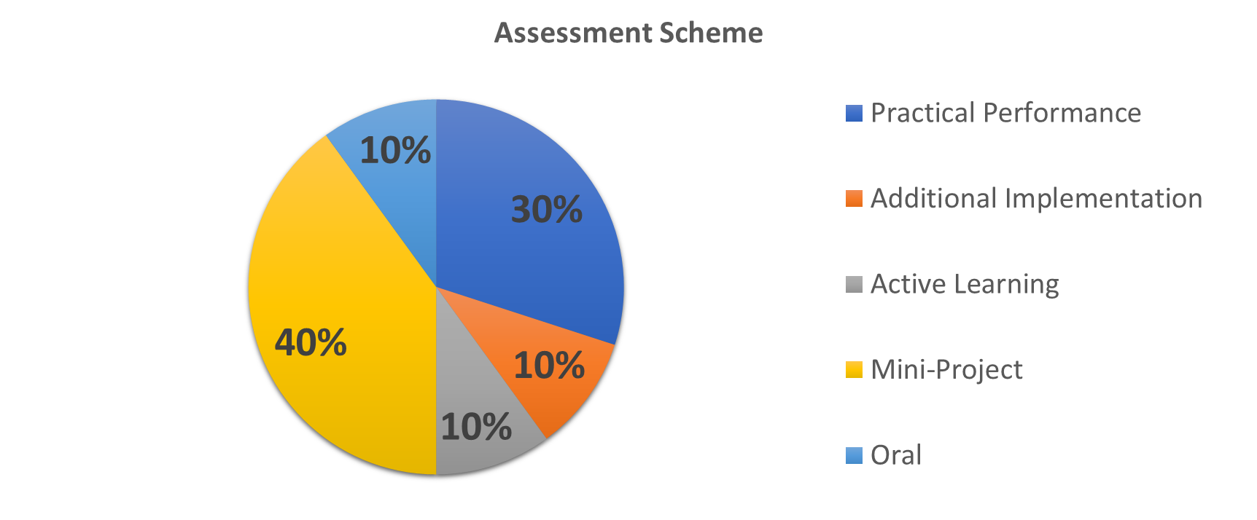
Rubrics: Practical Performance [30 Marks]
Excellent (25-30) | Good (20-24) | Satisfactory (15-19) | Needs Improvement (12-15) | Poor (<12)
Task Accomplishment & Understanding | Comprehensive understanding. Successful completion of all tasks with high proficiency. | Accomplished tasks with minor errors. Good understanding, occasional struggles. | Partial completion, limited understanding. Difficulties with key tasks. | Failed to complete essential tasks. Lack of understanding, significant gaps in knowledge.
Documentation & Organization | Clear & well-structured documentation. Systematic organization with thorough explanations. | Adequate documentation with occasional gaps. Satisfactory organization. | Limited & disorganized documentation. Deficiencies in code comments & explanations. | Lacks proper documentation & organization. Poorly explained, challenging to comprehend.
Technical Skills & Implementation | Exceptional technical skills. Clean, efficient, & well-structured code. | Good technical skills. Minor coding issues. Acceptable code quality. | Some technical proficiency, noticeable problems. Suboptimal or error-prone code. | Lacks required technical skills. Error-prone, poorly structured & inefficient code.
Creativity & Innovation | Highly creative & innovative solution. Unique features enhancing the project. | Shows creativity, some unique elements. Additional features with moderate impact. | Limited creativity, conventional approach. Meets basic requirements. | Lacks creativity & innovation. Only fulfills basic requirements, no unique elements.
Problem Solving & Error Handling | Excellent problem-solving. Robust error handling. | Satisfactory problem-solving. Basic error handling. | Struggles with problem-solving & error handling. Requires significant assistance. | Poor problem-solving & error handling. Numerous unresolved issues. Ineffective error management.
Presentation & User Experience | Polished & professional user experience. Intuitive & visually appealing UI. | Satisfactory user experience. Some room for improvement. | Unsatisfactory user experience. Design & usability issues. | Poor user experience. Unappealing & confusing UI.

Slide 9
Rubrics: Mini Project + Oral +Active Learning [ 40 Marks+ 10 Marks + 10 Marks ]
Criteria | Excellent (45-60 marks) | Good (35-44 marks) | Satisfactory (25-34 marks) | Needs Improvement (Below 25 marks)
Project Implementation & Functionality | Fully functional and well-implemented project, exceeding requirements with clean code and innovative features. | Mostly functional project with minor bugs, meets most requirements. | Partially functional project with notable problems, struggles with certain aspects. | Incomplete and error-prone project, significant gaps in implementation and features.
Documentation & Code Quality | Comprehensive documentation, well-commented code adhering to best practices, organized project structure. | Adequate documentation and code quality, some areas for improvement. | Limited and disorganized documentation, inconsistent code quality and organization. | Poor documentation, code lacks comments, chaotic organization, subpar code quality.
Creativity & Innovation | Highly creative and innovative project, introducing unique features beyond basic requirements. | Shows creativity with additional elements, but lacks cohesion and major impact. | Limited creativity, closely follows basic requirements. | Lacks creativity, no unique elements, and fails to enhance project significantly.
Oral Exam & Presentation | Thorough understanding, clear and engaging presentation, confidently answers questions with in-depth knowledge. | Good understanding, satisfactory presentation, answers questions but may struggle with complexity. | Limited understanding, disorganized presentation, difficulties in answering questions. | Poor understanding, unengaging presentation, inadequate responses to questions.
Overall Project Outcome | Highly polished and professional outcome, intuitive user experience, meets all requirements with a complete application. | Mostly polished outcome, satisfactory user experience, meets most requirements. | Basic outcome with unsatisfactory user experience, missing key elements or functionality. | Poor and unprofessional outcome, confusing user experience, fails to meet requirements significantly.
ORAL
Active Learning

Slide 10
Mini-Project
Max 4 Students in a group
All concepts covered in lab to be showcased in the mini-project
One mandatory additional Concept which might not be covered in lab to be included in the mini-project
Total marks for mini project will be 70. split in the rubrics given previous slide
Assessment will be carried out in 3 phases:
Review 1: Topic finalization and wireframing (10 marks)
Review 2: Front-end completion (20 marks)
Review 3: Backend connectivity/Full running product (40 marks)

Slide 11
List of Assignments
Lab | Assignment Statement | Workload in Hrs
 |  | Lab
1 | Created a public git repository for your team and submit the repo URL as the solution to this assignment, Learn Git concept of Local and Remote Repository, Push, Pull, Merge and Branch. | 04
2 | Design and develop a responsive web page using Bootstrap front end framework. Web pages should contain HTML5 elements (Use all possible formatting for example font, colour etc.). Web page should include various images, links within the page, links to other pages for navigation, new tabs. | 04
3 | Write a program to perform following form validations using JavaScript: All fields mandatory, Phone number, Email Address, Zip code Validation etc. Include JavaScript to access and manipulate Document Object Model (DOM) objects in an HTML web page. Include JQuery to develop to develop your application as an Ajax based application. | 04
4 | Write server side script in PHP to perform form validation and create database application using PHP and MySQL to perform insert, update, delete and search operations. | 06
5 | Design and develop an interactive user interface using React. | 10
6 | Develop a set of REST API using Express and Node. | 08
7 | Develop a full stack web application using MERN stack to perform CRUD operations. | 12

Slide 12
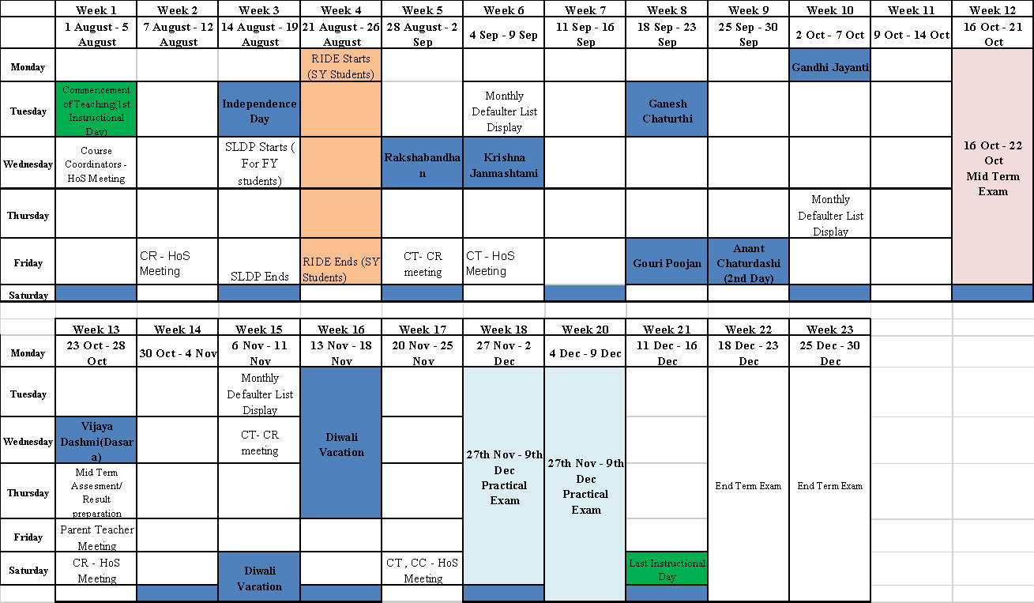
Academic Planner

Slide 13
Tentative Planning
Lab | Assignment Statement | Workload in Hrs | Tentative Schedule
 |  | Lab
1 | Created a public git repository for your team and submit the repo URL as the solution to this assignment, Learn Git concept of Local and Remote Repository, Push, Pull, Merge and Branch. | 04 | Week1
2 | Design and develop a responsive web page using Bootstrap front end framework. Web pages should contain HTML5 elements (Use all possible formatting for example font, colour etc.). Web page should include various images, links within the page, links to other pages for navigation, new tabs. | 04 | Week2
3 | Write a program to perform following form validations using JavaScript: All fields mandatory, Phone number, Email Address, Zip code Validation etc. Include JavaScript to access and manipulate Document Object Model (DOM) objects in an HTML web page. Include JQuery to develop to develop your application as an Ajax based application. | 04 | Week3
4 | Write server side script in PHP to perform form validation and create database application using PHP and MySQL to perform insert, update, delete and search operations. | 06 | Week4,5,6,7
5 | Design and develop an interactive user interface using React. | 10
6 | Develop a set of REST API using Express and Node. | 08 | Week 8, 9
7 | Develop a full stack web application using MERN stack to perform CRUD operations. | 12 | Week 10,11,12
8 | Mini Project (based on technology stacks learned) | 12

